Slide 1
Informed search algorithms

Slide 2
Outline
Best-first search
  Greedy best-first search
  A* search
Local search algorithms
Hill-climbing search
Simulated annealing search
Local beam search
Genetic algorithms

Slide 3
Best-first search
Idea: use an evaluation function f(n) for each node
  f(n) provides an estimate for the total cost.
  Expand the node n with smallest f(n).
Implementation:
Order the nodes in fringe increasing order of cost.
Special cases:
  greedy best-first search
  A* search

Slide 4
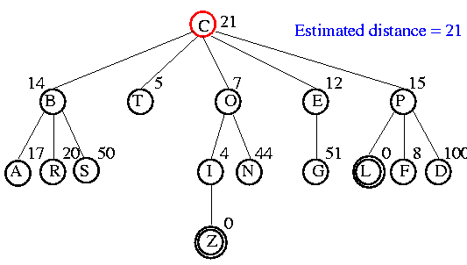
Example

Slide 5
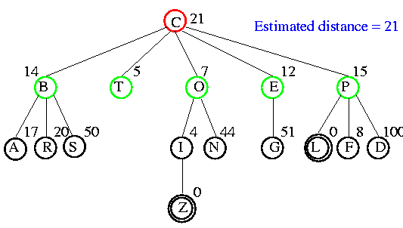
Example

Slide 6
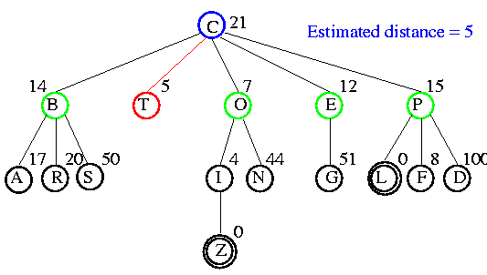
Example

Slide 7
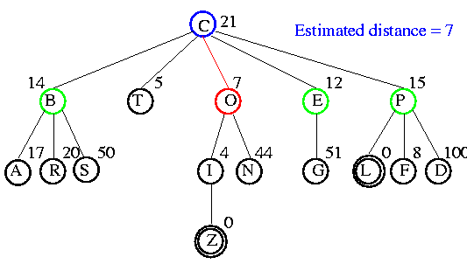
Example

Slide 8
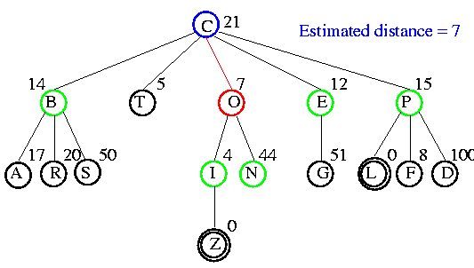
Example

Slide 9
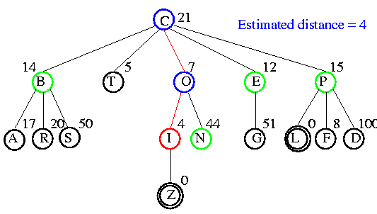
Example

Slide 10
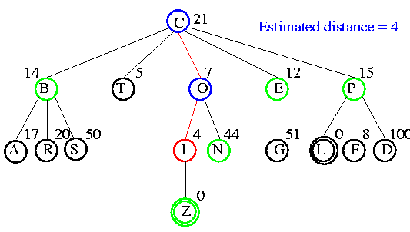
Example

Slide 11
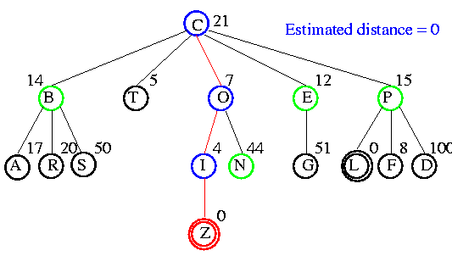
Example

Slide 12
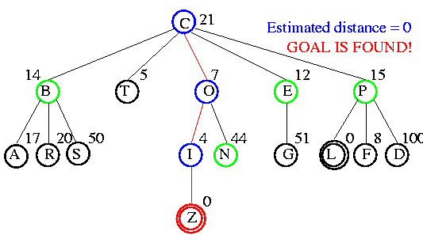
Example

Slide 13

Romania with straight-line dist.

Slide 14
Greedy best-first search
f(n) = estimate of cost from n to goal
e.g., f_{SLD}(n) = straight-line distance from n to Bucharest
Greedy best-first search expands the node that appears to be closest to goal.

Slide 15

Greedy best-first search example

Slide 16

Greedy best-first search example

Slide 17

Greedy best-first search example

Slide 18

Greedy best-first search example

Slide 19
Properties of greedy best-first search
Complete? No – can get stuck in loops.
Time? O(b^{m}), but a good heuristic can give dramatic improvement
Space? O(b^{m}) - keeps all nodes in memory
Optimal? No
e.g. Arad→Sibiu→Rimnicu Virea→Pitesti→Bucharest is shorter!

Slide 20
A* search
Idea: avoid expanding paths that are already expensive
Evaluation function f(n) = g(n) + h(n)
g(n) = cost so far to reach n
h(n) = estimated cost from n to goal
f(n) = estimated total cost of path through n to goal
Best First search has f(n)=h(n)

Slide 21

A* search example

Slide 22

A* search example

Slide 23

A* search example

Slide 24

A* search example

Slide 25

A* search example

Slide 26

A* search example

Slide 27
Admissible heuristics
A heuristic h(n) is admissible if for every node n,
h(n) ≤ h*(n), where h*(n) is the true cost to reach the goal state from n.
An admissible heuristic never overestimates the cost to reach the goal, i.e., it is optimistic
Example: h_{SLD}(n) (never overestimates the actual road distance)
Theorem: If h(n) is admissible, A* using TREE-SEARCH is optimal

Slide 28

Optimality of A* (proof)
Suppose some suboptimal goal G₂ has been generated and is in the fringe. Let n be an unexpanded node in the fringe such that n is on a shortest path to an optimal goal G.
f(G₂) > f(G) copied from last slide
h(n) ≤ h*(n) since h is admissible (under-estimate)
g(n) + h(n) ≤ g(n) + h*(n) from above
f(n) ≤ f(G) since g(n)+h(n)=f(n) & g(n)+h*(n)=f(G)
f(n) < f(G2) from top line.
Hence: n is preferred over G2

Slide 29

Consistent heuristics
A heuristic is consistent if for every node n, every successor n' of n generated by any action a, can be represented as:
h(n) ≤ c(n,a,n') + h(n')
If h is consistent, we have
f(n') = g(n') + h(n')
= g(n) + c(n,a,n') + h(n')
≥ g(n) + h(n)
f(n’) ≥ f(n)
i.e., f(n) is non-decreasing along any path.
Theorem:
If h(n) is consistent, A* using GRAPH-SEARCH is optimal
It’s the triangle
inequality !
keeps all checked nodes
in memory to avoid repeated
states

Slide 30

Optimality of A*
A* expands nodes in order of increasing f value
Gradually adds "f-contours" of nodes
Contour i contains all nodes with f≤f_{i} where f_{i} < f_{i+1}

Slide 31
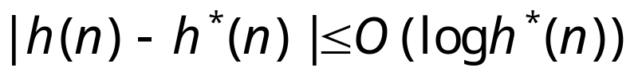
Properties of A*
Complete? Yes (unless there are infinitely many nodes with f ≤ f(G) , i.e. path-cost > ε)
Time/Space? Exponential
except if:
Optimal? Yes
Optimally Efficient: Yes (no algorithm with the
same heuristic is guaranteed to expand fewer nodes)

Slide 32
Memory Bounded Heuristic Search: Recursive BFS
How can we solve the memory problem for A* search?
Idea: Try something like depth first search, but let’s not forget everything about the branches we have partially explored.
We remember the best f-value we have found so far in the branch we are deleting.

Slide 33

Admissible heuristics
E.g., for the 8-puzzle:
h₁(n) = number of misplaced tiles
h₂(n) = total Manhattan distance
(i.e., no. of squares from desired location of each tile)
h₁(S) = ?
h₂(S) = ?

Slide 34
Admissible heuristics
E.g., for the 8-puzzle:
h₁(n) = number of misplaced tiles
h₂(n) = total Manhattan distance
(i.e., no. of squares from desired location of each tile)
h₁(S) = ? 8
h₂(S) = ? 3+1+2+2+2+3+3+2 = 18

Slide 35
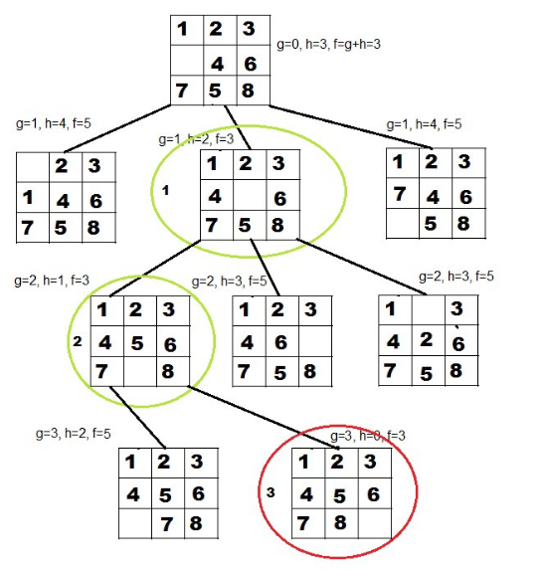
Example

Slide 36
Exercise
2 | 8 | 3
1 | 6 | 4
7 |  | 5
1 | 2 | 3
8 |  | 4
7 | 6 | 5
Initial State | Goal State

Slide 37
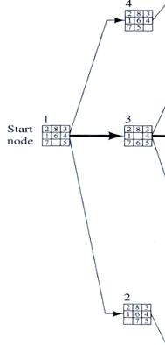

Slide 38
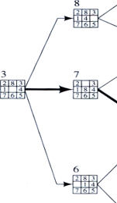

Slide 39
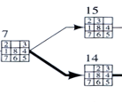

Slide 40


Slide 41


Slide 42
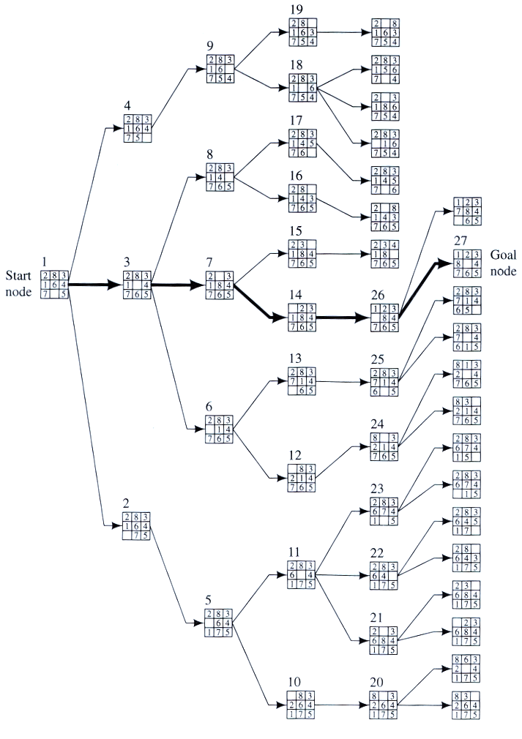
Example
BFS

Slide 43
Dominance
If h₂(n) ≥ h₁(n) for all n (both admissible)
then h₂ dominates h₁
h₂ is better for search: it is guaranteed to expand
less nodes.
Typical search costs (average number of nodes expanded):
d=12 IDS = 3,644,035 nodes
A*(h₁) = 227 nodes
A*(h₂) = 73 nodes
d=24 IDS = too many nodes
A*(h₁) = 39,135 nodes
A*(h₂) = 1,641 nodes

Slide 44
Relaxed problems
A problem with fewer restrictions on the actions is called a relaxed problem
The cost of an optimal solution to a relaxed problem is an admissible heuristic for the original problem
If the rules of the 8-puzzle are relaxed so that a tile can move anywhere, then h₁(n) gives the shortest solution
If the rules are relaxed so that a tile can move to any adjacent square, then h₂(n) gives the shortest solution

Slide 45
Local search algorithms
In many optimization problems, the path to the goal is irrelevant; the goal state itself is the solution
State space = set of "complete" configurations
Find configuration satisfying constraints, e.g., n-queens
In such cases, we can use local search algorithms
keep a single "current" state, try to improve it.
Very memory efficient (only remember current state)
Key advantages:
  Use less memory
  Often find reasonable solutions in large state spaces.

Slide 46

Hill-climbing search: 8-queens problem
Each number indicates h if we move
a queen in its corresponding column
Put n queens on an n × n board with no two queens on the same row, column, or diagonal
h = number of pairs of queens that are attacking each other, either directly or indirectly (h = 17 for the above state)

Slide 47

Hill-climbing search
Problem: depending on initial state, can get stuck in local maxima

Slide 48
Simulated annealing search
Idea: escape local maxima by allowing some "bad" moves but gradually decrease their frequency.
This is like smoothing the cost landscape.

Slide 49
Properties of simulated annealing search
One can prove: If T decreases slowly enough, then simulated annealing search will find a global optimum with probability approaching 1 (however, this may take VERY long)
Widely used in VLSI layout, airline scheduling, etc.

Slide 50
Local beam search
Keep track of k states rather than just one.
Start with k randomly generated states.
At each iteration, all the successors of all k states are generated.
If any one is a goal state, stop; else select the k best successors from the complete list and repeat.

Slide 51
What is GA
A genetic algorithm (or GA) is a search technique used in computing to find true or approximate solutions to optimization and search problems.
Genetic algorithms are categorized as global search heuristics.
Genetic algorithms are a particular class of evolutionary algorithms that use techniques inspired by evolutionary biology such as inheritance, mutation, selection, and crossover (also called recombination).

Slide 52
Key terms
Individual - Any possible solution
Population - Group of all individuals
Search Space - All possible solutions to the problem
Chromosome - Blueprint for an individual
Trait - Possible aspect (features) of an individual
Allele - Possible settings of trait (black, blond, etc.)
Locus - The position of a gene on the chromosome
Genome - Collection of all chromosomes for an individual

Slide 53
GA Requirements
a genetic representation of the solution domain, and
a fitness function to evaluate the solution domain.
A standard representation of the solution is as an array of bits. Arrays of other types and structures can be used in essentially the same way.
The main property that makes these genetic representations convenient is that their parts are easily aligned due to their fixed size, that facilitates simple crossover operation.
Variable length representations may also be used, but crossover implementation is more complex in this case.
Tree-like representations are explored in Genetic programming.

Slide 54
General Algorithm for GA
Initialization
  Initially many individual solutions are randomly generated to form an initial population.
Fitness Function
Selection
  During each successive generation, a proportion of the existing population is selected to breed a new generation selected through fitness function
Reproduction
Crossover
Mutation

Slide 55
Representation
Chromosomes could be:
  Bit strings (0101 ... 1100)
  Real numbers (43.2 -33.1 ... 0.0 89.2)
  Permutations of element (E11 E3 E7 ... E1 E15)
  Lists of rules (R1 R2 R3 ... R22 R23)
  Program elements (genetic programming)
  ... any data structure ...

Slide 56
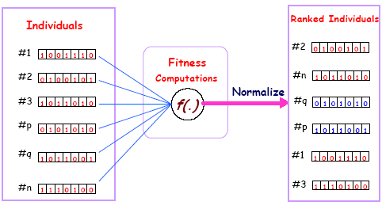
A fitness function

Slide 57
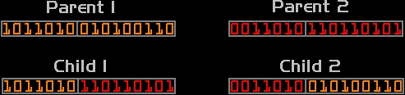
Crossover

Slide 58

Mutation

Slide 59
General Algorithm for GA
Termination
This generational process is repeated until a termination condition has been reached.
Common terminating conditions are:
  A solution is found that satisfies minimum criteria
  Fixed number of generations reached
  Allocated budget (computation time/money) reached
  The highest ranking solution's fitness is reaching or has reached a plateau such that successive iterations no longer produce better results
  Manual inspection
  Any Combinations of the above

Slide 60
Aplications
Routing Problems
Financial markets
Manufacturing System
Engineering Design
Data clustering
Neural Nteworks
Medical Sciences

Slide 61
Example
f(x) = {MAX(x²): 0 <= x <= 32 }
Encode Solution: Just use 5 bits (1 or 0).
Generate initial population.
Evaluate each solution against objective.
A | 0 | 1 | 1 | 0 | 1
B | 1 | 1 | 0 | 0 | 0
C | 0 | 1 | 0 | 0 | 0
D | 1 | 0 | 0 | 1 | 1
Sol. | String | Fitness | % of Total
A | 01101 | 169 | 14.4
B | 11000 | 576 | 49.2
C | 01000 | 64 | 5.5
D | 10011 | 361 | 30.9

Slide 62
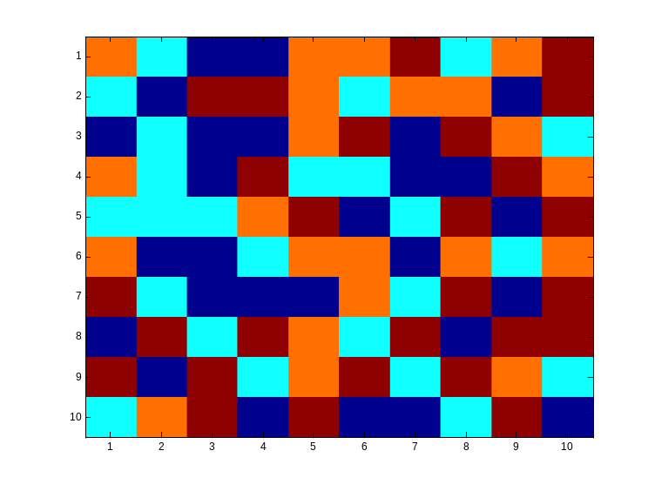
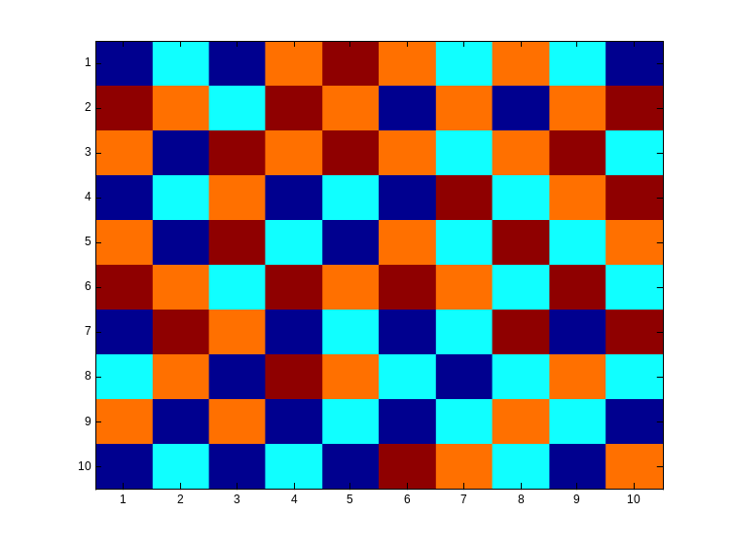
Checkboard example
  We are given an n by n checkboard in which every field can have a different colour from a set of four colors.
  Goal is to achieve a checkboard in a way that there are no neighbours with the same color (not diagonal)

Slide 63
Checkboard example Cont’d
  Chromosomes represent the way the checkboard is colored.
  Chromosomes are not represented by bitstrings but by bitmatrices
  The bits in the bitmatrix can have one of the four values 0, 1, 2 or 3, depending on the color.
  Crossing-over involves matrix manipulation instead of point wise operating.
  Crossing-over can be combining the parential matrices in a horizontal, vertical, triangular or square way.
  Mutation remains bitwise changing bits in either one of the other numbers.

Slide 64
Checkboard example Cont’d
  This problem can be seen as a graph with n nodes and (n-1) edges, so the fitness f(x) is defined as:
  f(x) = 2 · (n-1) ·n

Slide 65


fitness:
#non-attacking queens
Fitness function: number of non-attacking pairs of queens
24/(24+23+20+11) = 31%
23/(24+23+20+11) = 29% etc
probability of being
regenerated
in next generation

Slide 66

Appendix

